Slide 1


A
HUMBLE
OFFERING

Slide 2

Mathematical Modeling, Analysis, and Optimal Control of Corruption Dynamics
[By Haileyesus Tessema Alemneh, Department of Mathematics, University of Gondar,Gondar, Ethiopia.]
Regd.no:20279

Slide 3
CONTENTS:
Introduction.
Model Formulation And Description.
Model Analysis.
Extension Of The Model Into Optimal Control.
Conclusions.
References.

Slide 4
INTRODUCTION
Corruption is an illegal activity carried out for private gain and benefit, by misuse of authority or power by public or private office holders.
Corruption can originate from either the demand side or supply side.
Corruption brings market economy at risk for their proper and fair functioning.
Though corruption control strategies are being made, it remains an epidemic in the society.
Mathematical models with optimal control analysis are an important tool in understanding the corruption transmission dynamics.

Slide 5
Model Formulation and Description
The total population N(t) is divided into five compartments. They are
Susceptible individuals S(t) : Those individuals who are susceptible to corruption.
Exposed individuals E(t) : Those individuals who are exposed to a corrupted person but do not perform it.
Corrupted individuals C(t) : Those individuals who are performing the corruption are corrupted individuals.
Recovered individuals R(t) : Those who stopped doing corruption are recovered individuals.
Honest individuals H(t) : Those individuals who do not perform it permanently are honest individuals.

Slide 6
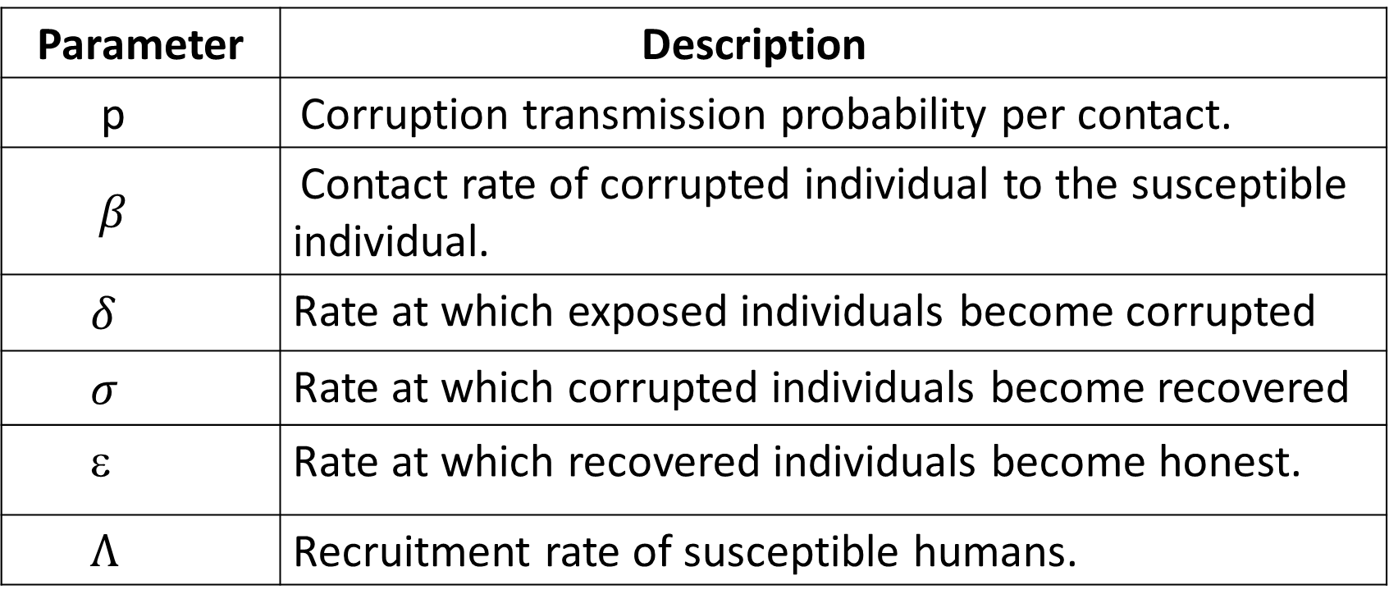
Description of parameters of corruption model
Parameter | Description
p | Corruption transmission probability per contact.
$β$ | Contact rate of corrupted individual to the susceptible individual.
$δ$ | Rate at which exposed individuals become corrupted
$σ$ | Rate at which corrupted individuals become recovered
ε | Rate at which recovered individuals become honest.
$Λ$ | Recruitment rate of susceptible humans.
κ | Proportion of individuals that joins the honest population from susceptible population.

Slide 7
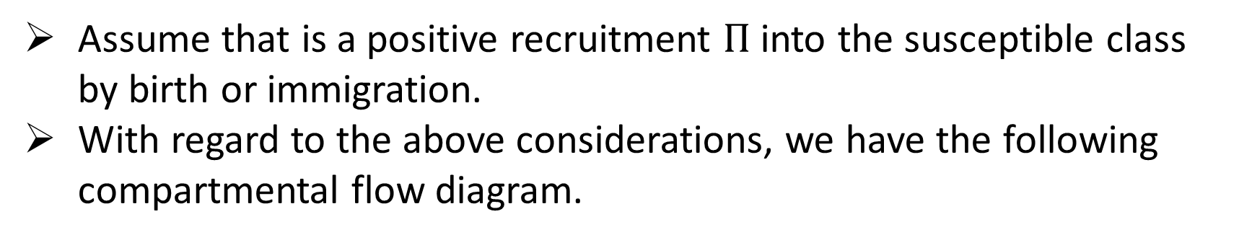
Parameter | Description
μ | Death rate of all humans.
α | Proportion of individuals that joins the corrupted subpopulation from exposed compartment.
θ | Proportion of individuals that joins the honest subpopulation from recovered compartment.
Assume that is a positive recruitment $Π$ into the susceptible class by birth or immigration.
With regard to the above considerations, we have the following compartmental flow diagram.

Slide 8
Compartmental diagram for the transmission dynamics of corruption
β
αδ
π
S
E
C
μ
μ
μ
(1-α)δ
σ
κ
(1-θ)ε
H
R
θε
μ
μ

Slide 9



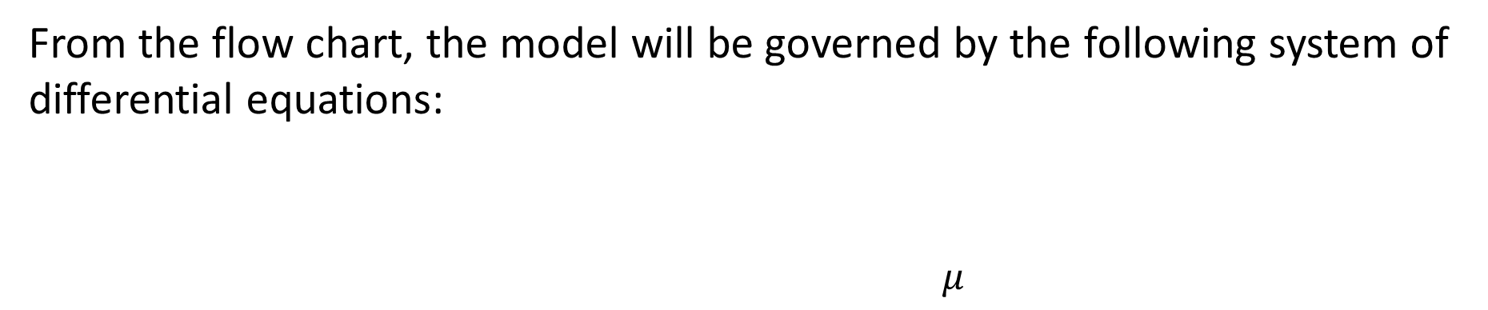

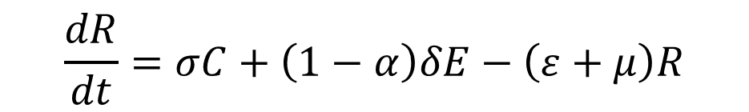


From the flow chart, the model will be governed by the following system of differential equations:
$μ$
$$\frac{dS}{dt}=Π+(1−θ)εR−pβSC−\left(k+μ\right)S$$
π
$$β$$
αδ
S
E
C
$$μ$$
μ
$$\frac{dE}{dt}=pβSC−\left(δ+μ\right)E$$
σ
(1-α)δ
κ
(1-θ)ε
$$\frac{dC}{dt}=αδE−\left(σ+μ\right)C$$
H
R
θε
$$\frac{dR}{dt}=σC+\left(1−α\right)δE−\left(ε+μ\right)R$$
μ
μ
$$\frac{dH}{dt}=kS+θεR−μH$$
1

Slide 10

With the initial conditions
S(0) = $S_{0}≥0,$
E(0) = $E_{0}≥0,$
I(0) = $I_{0}≥0,$
R(0) = $R_{0}≥0,$
H(0) = $H_{0}≥0.$

Slide 11
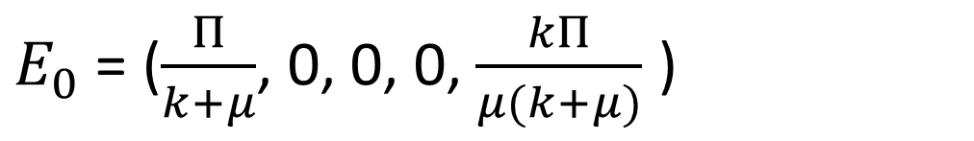
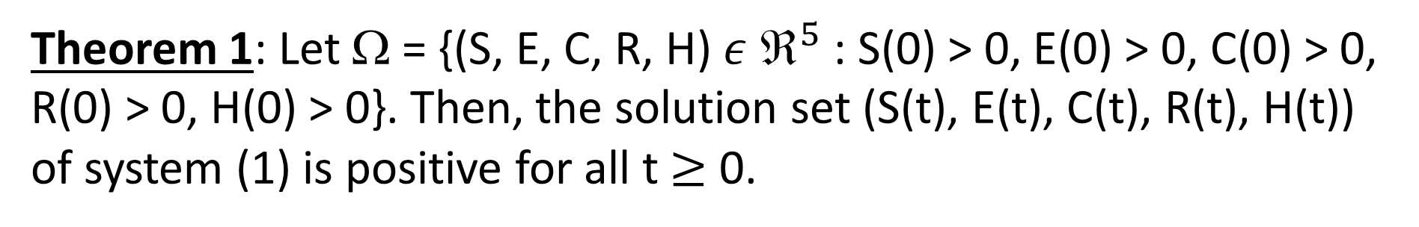
MODEL ANALYSIS
Theorem 1: Let Ω = {(S, E, C, R, H) $ε$ $^{5}$ : S(0) > 0, E(0) > 0, C(0) > 0, R(0) > 0, H(0) > 0}. Then, the solution set (S(t), E(t), C(t), R(t), H(t)) of system (1) is positive for all t$≥$ 0.
Corruption-Free Equilibrium Point (CFEP) : The corruption-free equilibrium point of equilibrium point of model (1) is obtained by equating all equations of model to zero and letting E=0, C=0, and R=0. Then we get
$E_{0}$ = ($\frac{Π}{k+μ}$, 0, 0, 0, $\frac{kΠ}{μ(k+μ)}$ )

Slide 12



Basic Reproduction number (BRN) :
The basic reproduction number $_{0}$ measures the expected number of secondary infections that result from one newly infected individual introduced into a susceptible population.
We calculate $_{0}$ of the model using the next generation matrix method.
Calculating $_{0}$ :
To get $_{0}$ we rewrite the model equations with model equations starting with newly infective classes.

Slide 13

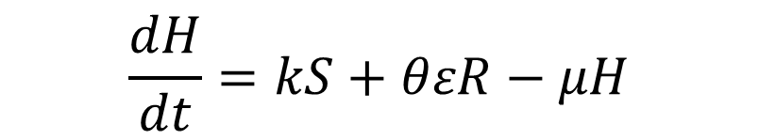
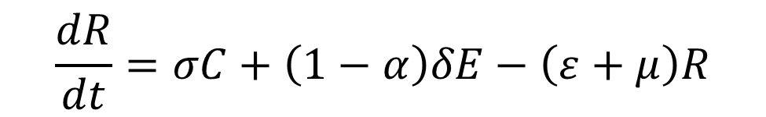
Now, our model is
$$\frac{dE}{dt}=pβSC−\left(δ+μ\right)E$$
$$\frac{dC}{dt}=αδE−\left(σ+μ\right)C$$
2
$$\frac{dR}{dt}=σC+\left(1−α\right)δE−\left(ε+μ\right)R$$
$$\frac{dH}{dt}=kS+θεR−μH$$

Slide 14
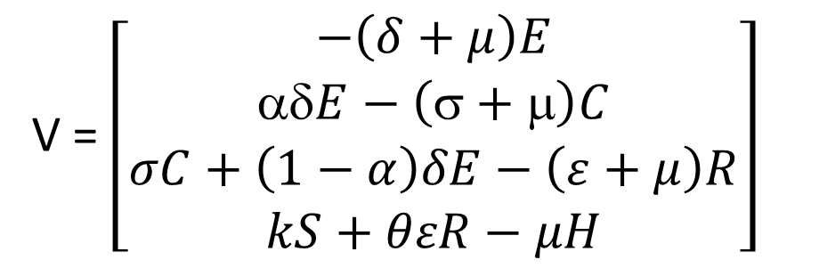

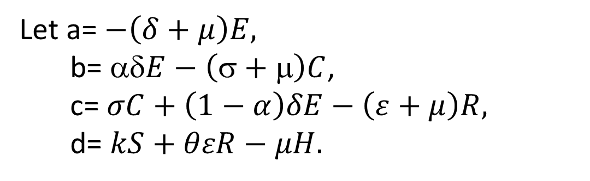
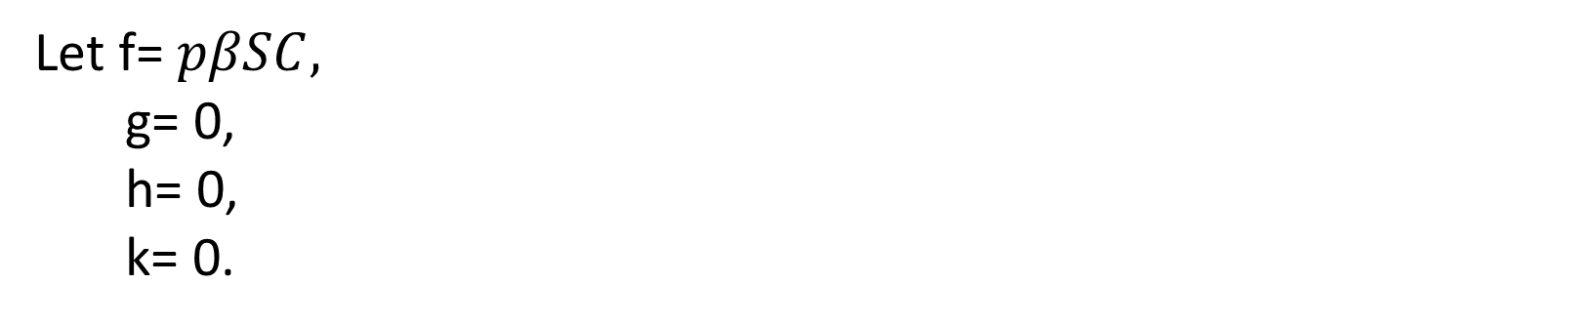
By the principle of next generation matrix method
$$ℱ=\left[\begin{matrix}pβSC \\ 0 \\ 0 \\ 0\end{matrix}\right]$$
V = $\left[\begin{matrix}−\left(δ+μ\right)E \\ δE−\left(σ+μ\right)C \\ σC+\left(1−α\right)δE−\left(ε+μ\right)R \\ kS+θεR−μH\end{matrix}\right]$
Let f= $pβSC,$
g= 0,
h= 0,
k= 0.
Let a= $−\left(δ+μ\right)E,$
b= $δE−\left(σ+μ\right)C$,
c= $σC+\left(1−α\right)δE−\left(ε+μ\right)R,$
d= $kS+θεR−μH.$

Slide 15

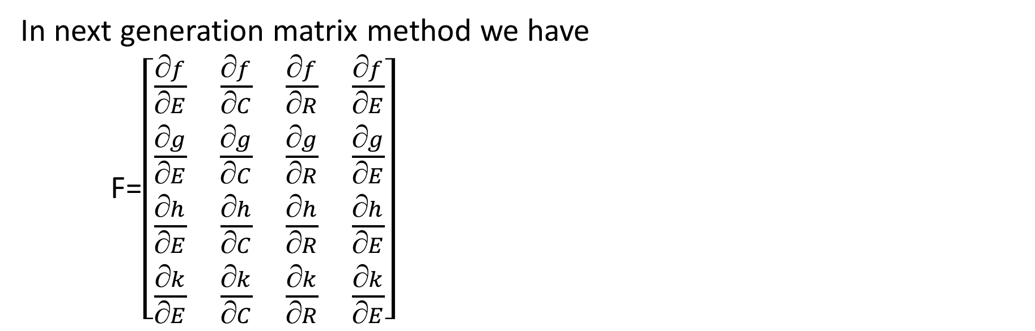

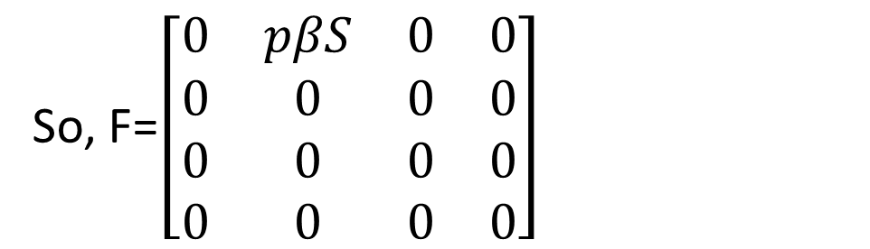
In next generation matrix method we have
F=$\left[\begin{matrix}\frac{f}{E} & \frac{f}{C} & \frac{f}{R} & \frac{f}{E} \\ \frac{g}{E} & \frac{g}{C} & \frac{g}{R} & \frac{g}{E} \\ \frac{h}{E} & \frac{h}{C} & \frac{h}{R} & \frac{h}{E} \\ \frac{k}{E} & \frac{k}{C} & \frac{k}{R} & \frac{k}{E}\end{matrix}\right]$
Where f = p$βS, g=0, h=0, k=0$
At CFEP we get F= $\left[\begin{matrix}0 & \frac{Πβp}{k+μ} & 0 & 0 \\ 0 & 0 & 0 & 0 \\ 0 & 0 & 0 & 0 \\ 0 & 0 & 0 & 0\end{matrix}\right]$
So, F=$\left[\begin{matrix}0 & pβS & 0 & 0 \\ 0 & 0 & 0 & 0 \\ 0 & 0 & 0 & 0 \\ 0 & 0 & 0 & 0\end{matrix}\right]$

Slide 16
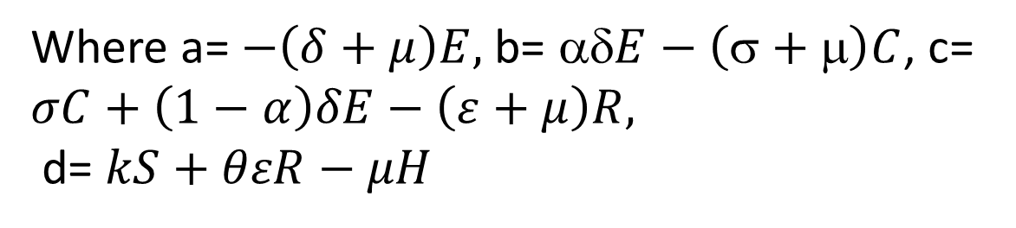
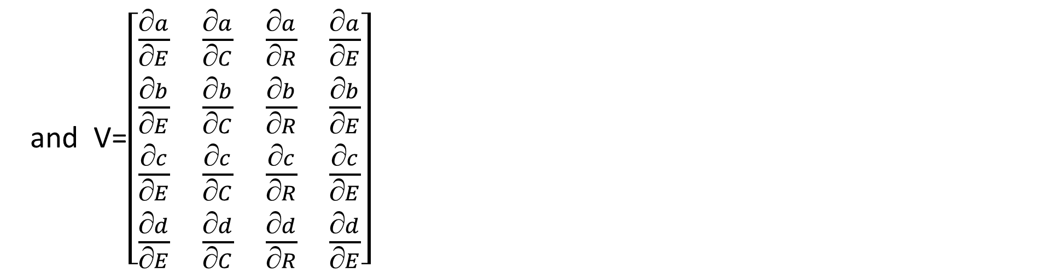
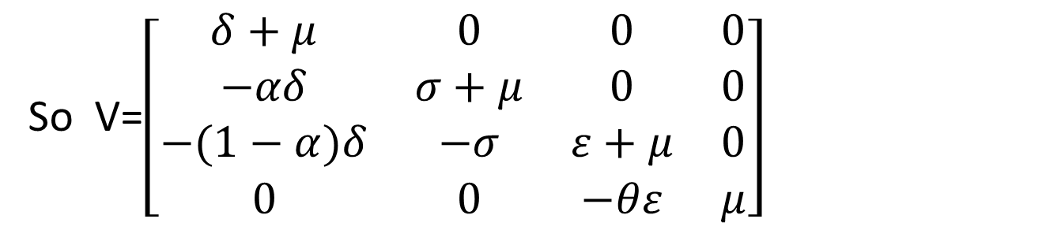
and V=$\left[\begin{matrix}\frac{a}{E} & \frac{a}{C} & \frac{a}{R} & \frac{a}{E} \\ \frac{b}{E} & \frac{b}{C} & \frac{b}{R} & \frac{b}{E} \\ \frac{c}{E} & \frac{c}{C} & \frac{c}{R} & \frac{c}{E} \\ \frac{d}{E} & \frac{d}{C} & \frac{d}{R} & \frac{d}{E}\end{matrix}\right]$
Where a= $−\left(δ+μ\right)E,$b= $δE−\left(σ+μ\right)C$, c= $σC+\left(1−α\right)δE−\left(ε+μ\right)R,$
d= $kS+θεR−μH$
So V=$\left[\begin{matrix}δ+μ & 0 & 0 & 0 \\ −αδ & σ+μ & 0 & 0 \\ −(1−α)δ & −σ & ε+μ & 0 \\ 0 & 0 & −θε & μ\end{matrix}\right]$

Slide 17
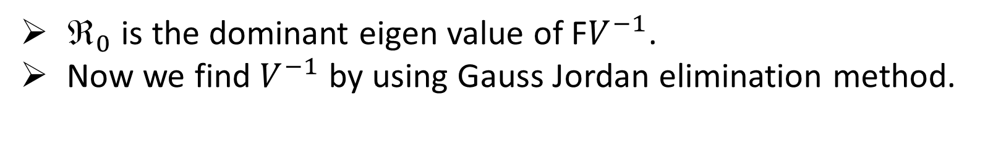
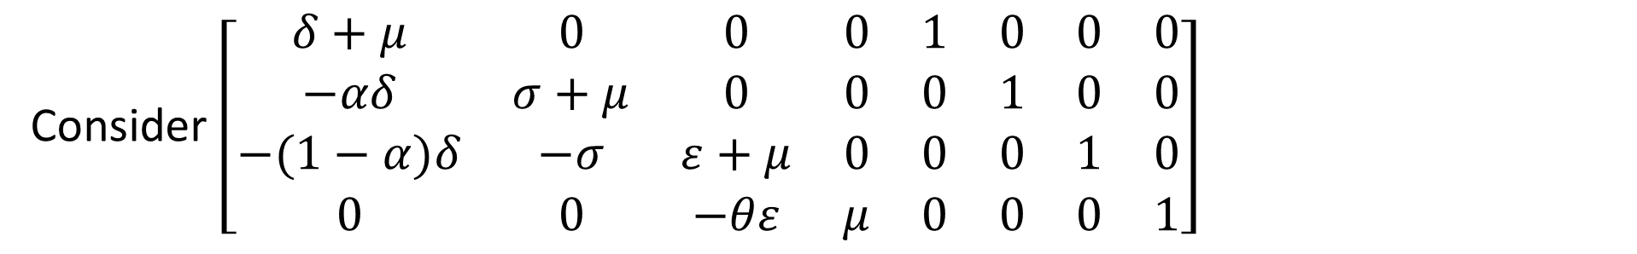
$_{0}$ is the dominant eigen value of F$V^{−1}$.
Now we find $V^{−1}$ by using Gauss Jordan elimination method.
Consider $\left[\begin{matrix}δ+μ & 0 & 0 & 0 & 1 & 0 & 0 & 0 \\ −αδ & σ+μ & 0 & 0 & 0 & 1 & 0 & 0 \\ −(1−α)δ & −σ & ε+μ & 0 & 0 & 0 & 1 & 0 \\ 0 & 0 & −θε & μ & 0 & 0 & 0 & 1\end{matrix}\right]$
By performing elementary row operations we get

Slide 18
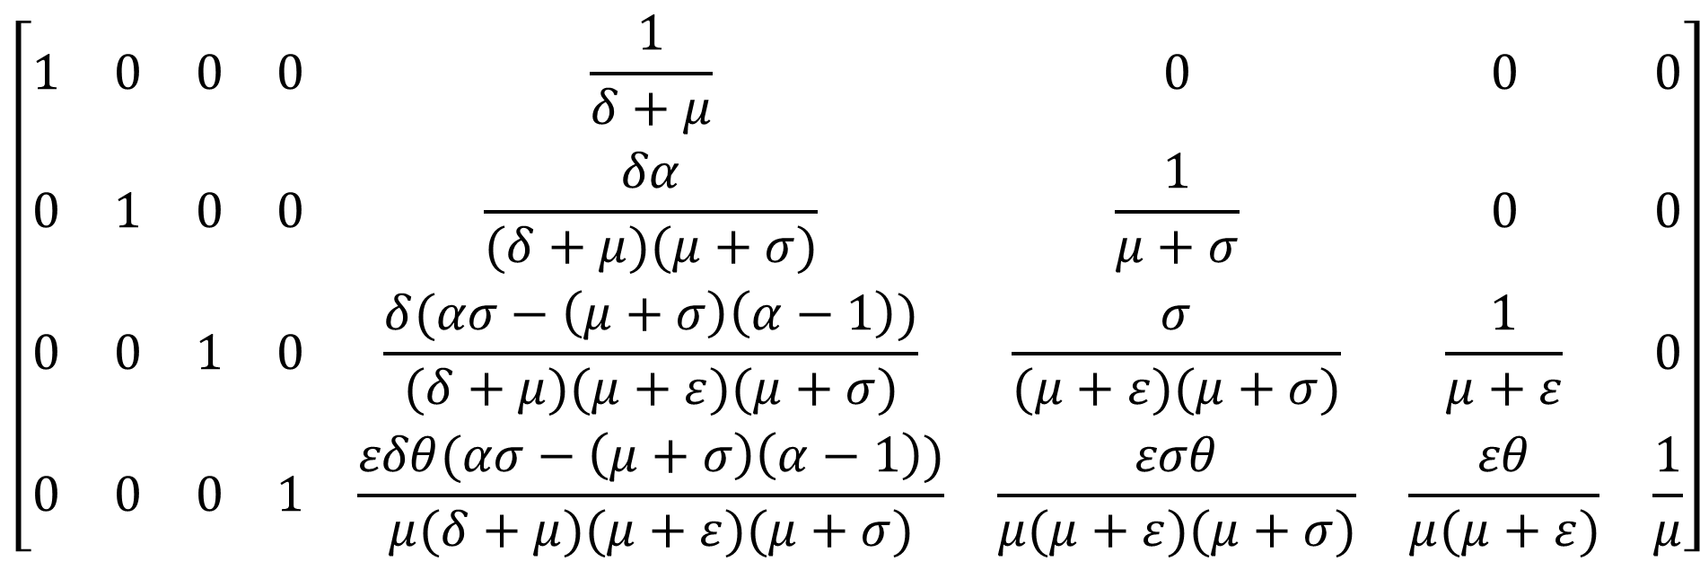
By elementary row operations we get
$$\left[\begin{matrix}1 & 0 & 0 & 0 & \frac{1}{δ+μ} & 0 & 0 & 0 \\ 0 & 1 & 0 & 0 & \frac{δα}{(δ+μ)(μ+σ)} & \frac{1}{μ+σ} & 0 & 0 \\ 0 & 0 & 1 & 0 & \frac{δ(ασ−\left(μ+σ\right)\left(α−1\right))}{(δ+μ)(μ+ε)(μ+σ)} & \frac{σ}{(μ+ε)(μ+σ)} & \frac{1}{μ+ε} & 0 \\ 0 & 0 & 0 & 1 & \frac{εδθ(ασ−\left(μ+σ\right)\left(α−1\right))}{μ(δ+μ)(μ+ε)(μ+σ)} & \frac{εσθ}{μ(μ+ε)(μ+σ)} & \frac{εθ}{μ(μ+ε)} & \frac{1}{μ}\end{matrix}\right]$$

Slide 19
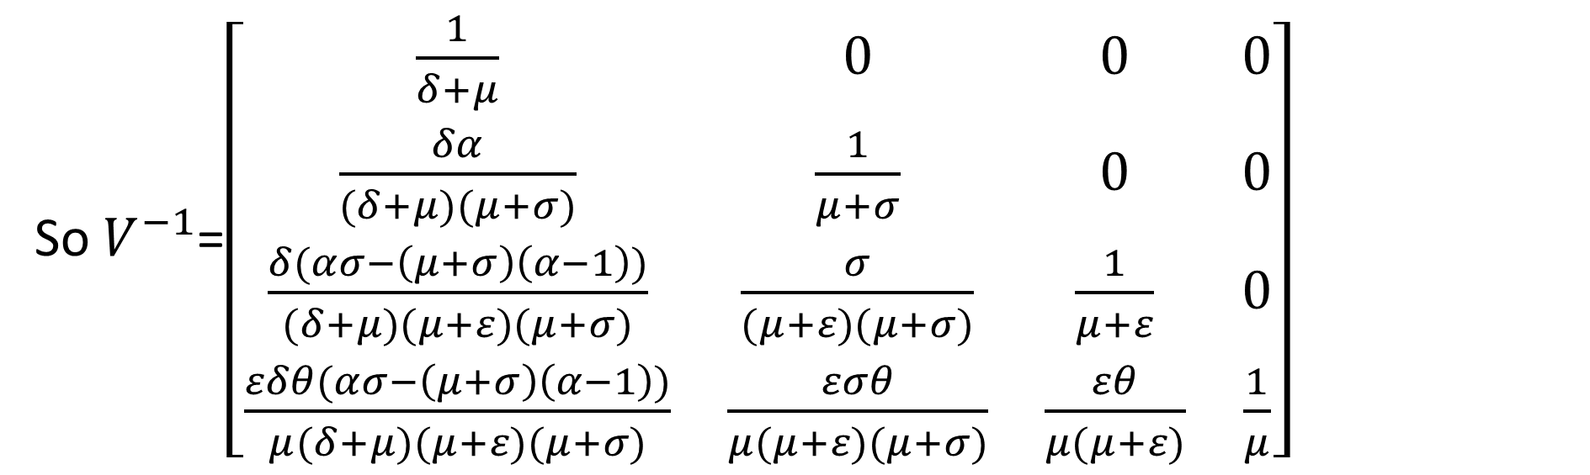
So $V^{−1}$=$\left[\begin{matrix}\frac{1}{δ+μ} & 0 & 0 & 0 \\ \frac{δα}{(δ+μ)(μ+σ)} & \frac{1}{μ+σ} & 0 & 0 \\ \frac{δ(ασ−\left(μ+σ\right)\left(α−1\right))}{(δ+μ)(μ+ε)(μ+σ)} & \frac{σ}{(μ+ε)(μ+σ)} & \frac{1}{μ+ε} & 0 \\ \frac{εδθ(ασ−\left(μ+σ\right)\left(α−1\right))}{μ(δ+μ)(μ+ε)(μ+σ)} & \frac{εσθ}{μ(μ+ε)(μ+σ)} & \frac{εθ}{μ(μ+ε)} & \frac{1}{μ}\end{matrix}\right]$

Slide 20
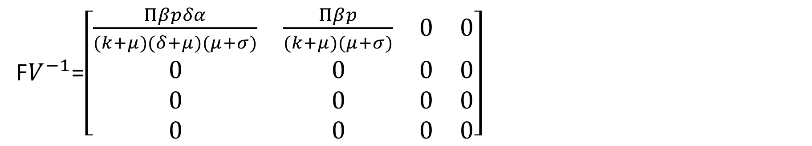
$_{0}$is the dominant eigen value of F$V^{−1}$, So we find F$V^{−1}$
F$V^{−1}$=$\left[\begin{matrix}\frac{Πβpδα}{(k+μ)(δ+μ)(μ+σ)} & \frac{Πβp}{(k+μ)(μ+σ)} & 0 & 0 \\ 0 & 0 & 0 & 0 \\ 0 & 0 & 0 & 0 \\ 0 & 0 & 0 & 0\end{matrix}\right]$
Characteristic equation of F$V^{−1}$ is (-$λ^{3}$)($\frac{Πβpδα}{(k+μ)(δ+μ)(μ+σ)}$-$λ$) = 0
$λ$= 0, $\frac{Πβpδα}{(k+μ)(δ+μ)(μ+σ)}$

Slide 21
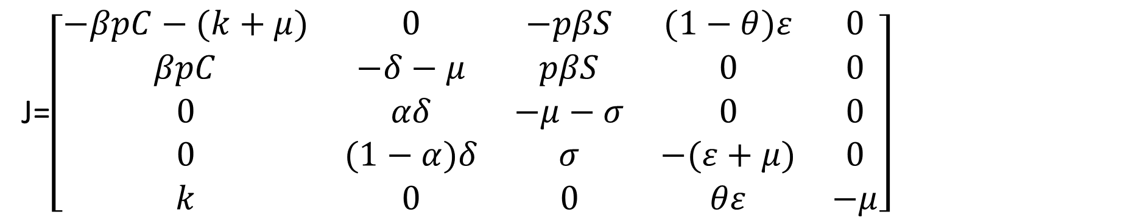
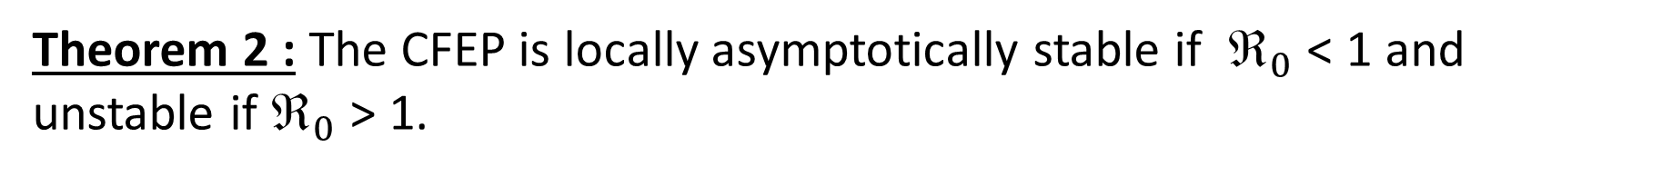
Since $_{0}$ is dominant eigen value
$_{0}$= $\frac{Πβpδα}{(k+μ)(δ+μ)(μ+σ)}$
Theorem 2 : The CFEP is locally asymptotically stable if $_{0}$ < 1 and unstable if $_{0}$ > 1.
Proof : The Jacobian matrix of system is
1
J=$\left[\begin{matrix}−βpC−(k+μ) & 0 & −pβS & (1−θ)ε & 0 \\ βpC & −δ−μ & pβS & 0 & 0 \\ 0 & αδ & −μ−σ & 0 & 0 \\ 0 & (1−α)δ & σ & −(ε+μ) & 0 \\ k & 0 & 0 & θε & −μ\end{matrix}\right]$

Slide 22
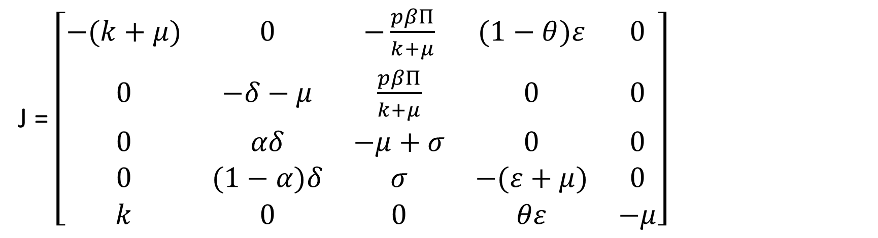
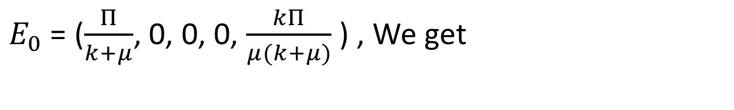
Evaluating the Jacobian matrix at corruption free equilibrium(CFEP)
$E_{0}$ = ($\frac{Π}{k+μ}$, 0, 0, 0, $\frac{kΠ}{μ(k+μ)}$ ) , We get
J = $\left[\begin{matrix}−(k+μ) & 0 & −\frac{pβΠ}{k+μ} & (1−θ)ε & 0 \\ 0 & −δ−μ & \frac{pβΠ}{k+μ} & 0 & 0 \\ 0 & αδ & −μ+σ & 0 & 0 \\ 0 & (1−α)δ & σ & −(ε+μ) & 0 \\ k & 0 & 0 & θε & −μ\end{matrix}\right]$
Characteristic polynomial of the Jacobian matrix is
(-$λ−\left(k+μ\right)\left(−λ−μ\right)\left(−λ−\left(ε+μ\right)\right)[λ^{2}+ ψ_{1}λ+ψ_{2}$] = 0
3

Slide 23
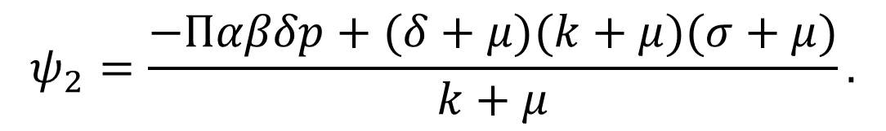
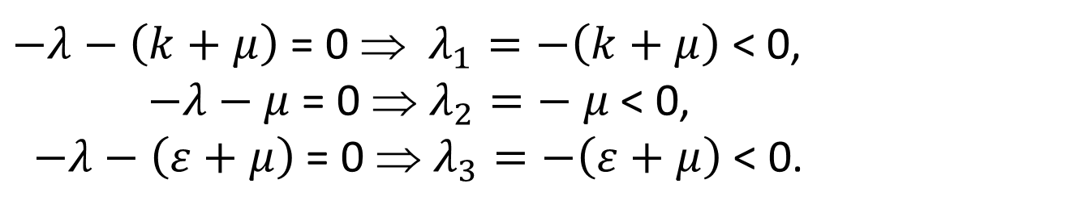
Where
$ψ_{1}$ = $σ+2μ+δ,$
$$ψ_{2}=\frac{−Παβδp+(δ+μ)(k+μ)(σ+μ)}{k+μ}.$$
From equation (3), we have
$−λ−\left(k+μ\right)$ = 0 $$ $λ_{1}=−\left(k+μ\right)$ < 0,
$−λ−μ$ = 0 $$ $λ_{2}=− μ$ < 0,
$−λ−\left(ε+μ\right)$ = 0 $$ $λ_{3}=−\left(ε+μ\right)$ < 0.
From last expression in equation (3), we have
$$λ^{2}+ ψ_{1}λ+ψ_{2}=0.$$
4
From Routh-Hurwitz criteria which states that any system can be stable iff all the roots have the same sign.

Slide 24

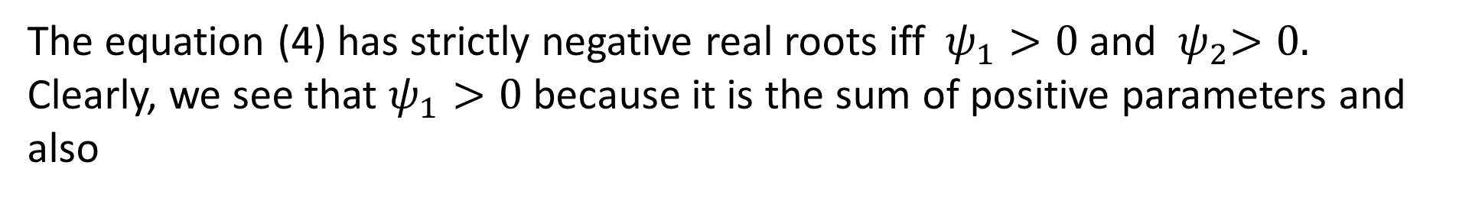
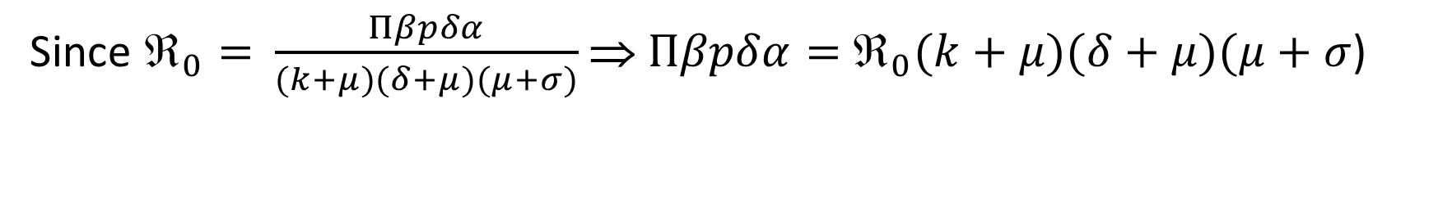
The equation (4) has strictly negative real roots iff $ψ_{1}>0$ and ${ ψ}_{2}>0.$
Clearly, we see that $ψ_{1}>0$ because it is the sum of positive parameters and also
$$ψ_{2}=\frac{−Παβδp+(δ+μ)(k+μ)(σ+μ)}{k+μ}$$
Since $_{0}=$ $\frac{Πβpδα}{(k+μ)(δ+μ)(μ+σ)}$ ⇒ $Πβpδα=$ $_{0}(k+μ)(δ+μ)(μ+σ$)
So $ψ_{2}=(δ+μ)(σ+μ)$(1 - $_{0}$) > 0 ⇒ $_{0}$ < 1.
Hence CFEP is locally asymptotically stable if $_{0}$ < 1.
Since corruption elimination is independent of the initial population size of the corrupted population, the CFEP is globally stable.

Slide 25

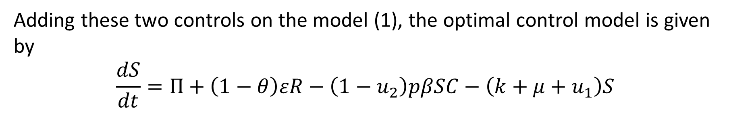
Extension of the model into optimal control
The optimal level that would be needed to control corruption is minimizing the number of exposed and corrupted population.
An optimal control model was developed by including the following two controls:
$u_{1}$: campaigning about corruption through media and advertisement
$\left(ii\right){ u}_{2}:$ exposing the corrupted individual to jail and giving punishment
Adding these two controls on the model (1), the optimal control model is given by
$$\frac{dS}{dt}=Π+\left(1−θ\right)εR−\left(1−u_{2}\right)pβSC−\left(k+μ+u_{1}\right)S$$
$$\frac{dE}{dt}=(1−u_{2)}pβSC−\left(δ+μ+u_{1}\right)E$$

Slide 26
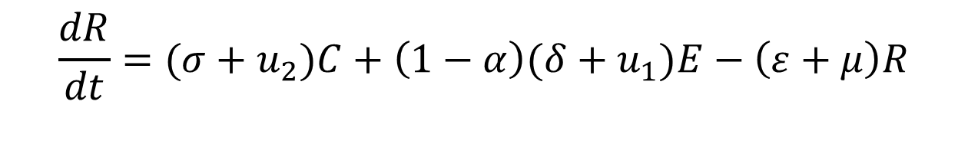
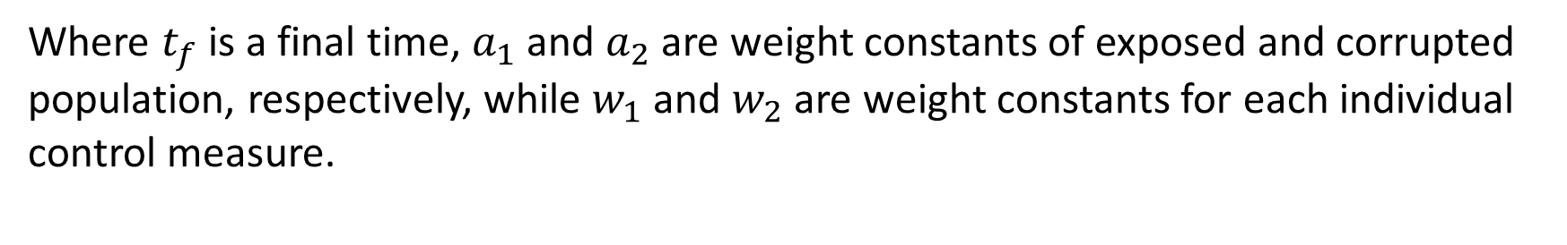

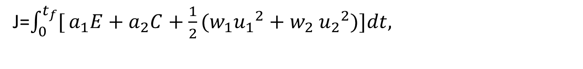


$$\frac{dC}{dt}=(1−u_{1})αδE−\left(σ+μ+u_{2}\right)C$$
$$\frac{dR}{dt}=(σ+u_{2})C+\left(1−α\right)(δ+u_{1})E−\left(ε+μ\right)R$$
$$\frac{dH}{dt}=(k−u_{1})S+θεR−μH$$
5
The control variables $u_{1}$and $u_{2}$ minimize the optimal control model (5) subject to the objective functional defined as
J=$\int_{0}^{t_{f}}{[}a_{1}E+a_{2}C+\frac{1}{2}(w_{1}{u_{1}}^{2}+w_{2}$ ${u_{2}}^{2})]dt,$
Where $t_{f}$ is a final time, $a_{1}$ and $a_{2}$ are weight constants of exposed and corrupted population, respectively, while $w_{1}$ and $w_{2}$ are weight constants for each individual control measure.

Slide 27

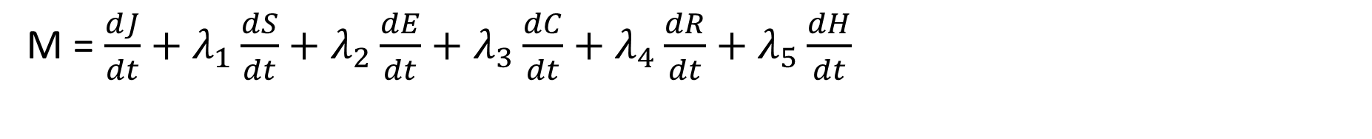
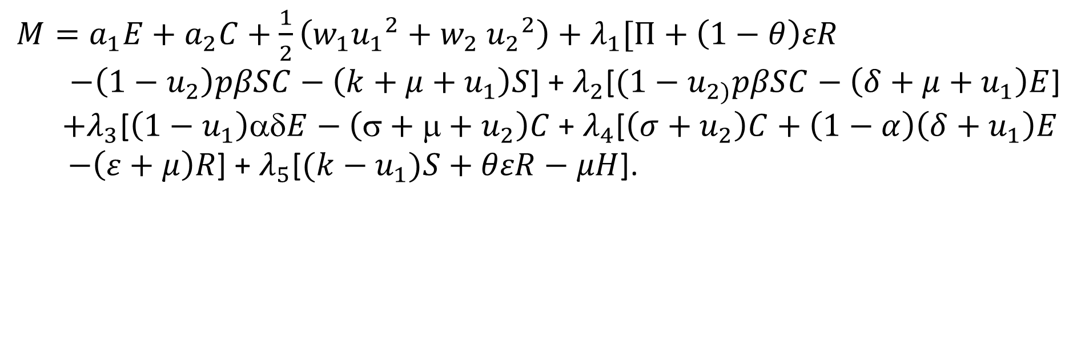
Hamiltonian (M) : The Hamiltonian operator is given by
M = $\frac{dJ}{dt}+λ_{1}\frac{dS}{dt}+λ_{2}\frac{dE}{dt}+λ_{3}\frac{dC}{dt}+λ_{4}\frac{dR}{dt}+λ_{5}\frac{dH}{dt}$
Where $λ_{i},i=1,2,3,4,5$ are adjoint variable functions which are to be determined.
${M=a}_{1}E+a_{2}C+\frac{1}{2}\left(w_{1}{u_{1}}^{2}+w_{2} {u_{2}}^{2}\right)+λ_{1}[Π+\left(1−θ\right)εR$
$−\left(1−u_{2}\right)pβSC−\left(k+μ+u_{1}\right)S$] + $λ_{2}$[$(1−u_{2)}pβSC−\left(δ+μ+u_{1}\right)E$]
$+λ_{3}$[$\left(1−u_{1}\right)αδE−\left(σ+μ+u_{2}\right)C$ + $λ_{4}$[$\left(σ+u_{2}\right)C+\left(1−α\right)\left(δ+u_{1}\right)E$
$−\left(ε+μ\right)R$] + $λ_{5}$[$(k−u_{1})S+θεR−μH$].
Now we will find adjoint variable system. The adjoint equation and transversality conditions are standard results obtained from Pontryagin’s maximum principle.

Slide 28
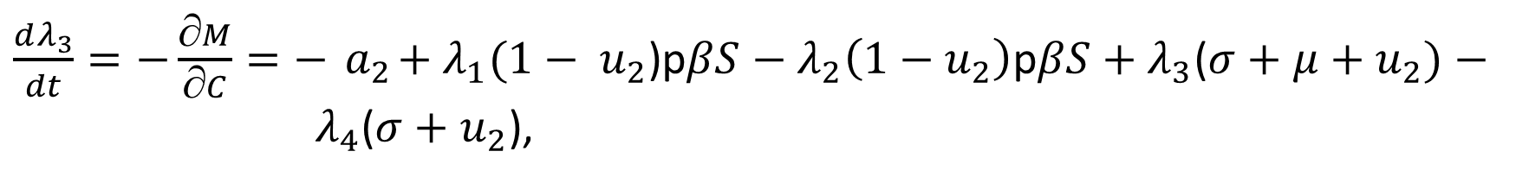
Pontryagin’s maximum principle is used in optimal control theory to find the best possible control for dynamic system.
According to Pontryagin’s maximum principle we differentiate the Hamiltonian operator with respect to S, E, C, R, H, respectively, then we got the adjoint operators as
$\frac{dλ_{1}}{dt}=−\frac{∂M}{∂S}=λ_{1}((1−{ u}_{2}$)p$βC+k+μ+{ u}_{1})−λ_{2}\left(1−u_{2}\right)pβC−λ_{5}(k+{ u}_{1})$,
$\frac{dλ_{2}}{dt}=−\frac{∂M}{∂E}=−{ a}_{1}+λ_{2}$($δ+μ+{ u}_{1})−λ_{3}αδ\left(1−{ u}_{1}\right)−λ_{4}(1−α)(δ+{ u}_{1}$),
$\frac{dλ_{3}}{dt}=−\frac{∂M}{∂C}=−{ a}_{2}+λ_{1}(1−{ u}_{2}\text{)}\text{p}βS−λ_{2}\left(1−{ u}_{2}\right)\text{p}βS+λ_{3}$($σ+μ+u_{2})− λ_{4}$($σ+u_{2}$),
$$\frac{dλ_{4}}{dt}=−\frac{∂M}{∂R}={−λ}_{1}ε\left(1−θ\right)+λ_{4}\left(ε+μ\right)−λ_{5}θε,$$
$$\frac{dλ_{5}}{dt}=−\frac{∂M}{∂R}=μλ_{5}.$$

Slide 29
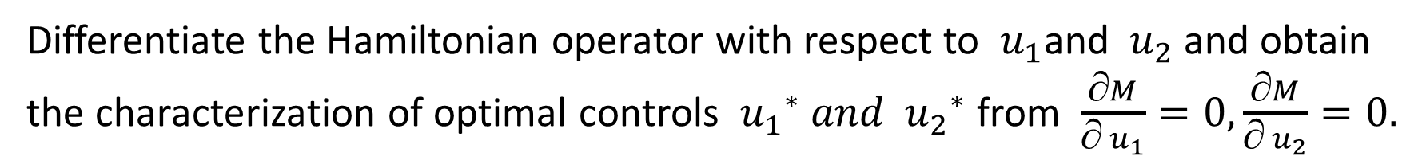

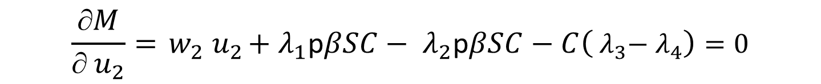

With transversality conditions, $λ_{i}\left(t_{f}\right)=0, i=1, 2, 3, 4, 5.$
Differentiate the Hamiltonian operator with respect to ${ u}_{1}$and ${ u}_{2}$ and obtain the characterization of optimal controls ${{ u}_{1}}^{∗} and {{ u}_{2}}^{∗}$ from $\frac{∂M}{∂{ u}_{1}}=0,\frac{∂M}{∂{ u}_{2}}=0.$
$$\frac{∂M}{∂{ u}_{1}}={ w}_{1}{ u}_{1}−s\left({ λ}_{1}−{ λ}_{5}\right)−E\left({ λ}_{2}+αδ{ λ}_{3}+\left(1−α\right){ λ}_{4}\right)=0$$
$${  u}_{1}=\frac{s\left({ λ}_{1}−{ λ}_{5}\right)+E\left({ λ}_{2+}αδ{ λ}_{3}+\left(1−α\right){ λ}_{4}\right)}{{ w}_{1}}$$
$$\frac{∂M}{∂{ u}_{2}}={ w}_{2}{ u}_{2}+{ λ}_{1}\text{p}βSC−{ λ}_{2}\text{p}βSC−C\left({ λ}_{3}−{ λ}_{4}\right)=0$$
$${  u}_{2}=\frac{\text{p}βSC\left({ λ}_{2}−{ λ}_{1}\right)+C\left({ λ}_{3}−{ λ}_{4}\right)}{{ w}_{2}}$$

Slide 30

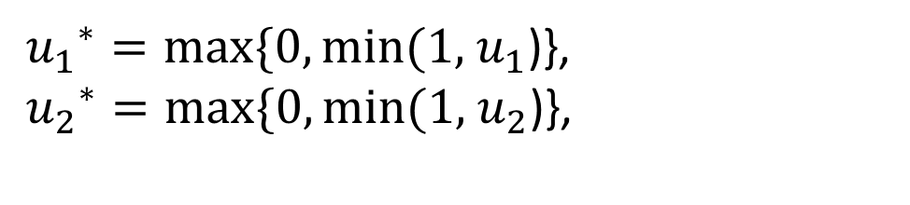
Thus in compact form:
${{ u}_{1}}^{∗}=max⁡\{0, min⁡(1,{ u}_{1}$)},
${{ u}_{2}}^{∗}=max⁡\{0, min⁡(1,{ u}_{2}$)},
The optimality system is formed from the optimal control system and the adjoint variable system with initial and transversality conditions.
The optimal system is:
$\frac{dS}{dt}=Π+\left(1−θ\right)εR−\left(1−{u_{2}}^{∗}\right)pβSC−\left(k+μ+{u_{1}}^{∗}\right)S,$
$\frac{dE}{dt}=(1−{u_{2}}^{∗})pβSC−\left(δ+μ+{u_{1}}^{∗}\right)E$,
$\frac{dC}{dt}=(1−{u_{1}}^{∗})αδE−\left(σ+μ+{u_{2}}^{∗}\right)C$,
$\frac{dR}{dt}=(σ+{u_{2}}^{∗})C+\left(1−α\right)(δ+{u_{1}}^{∗})E−\left(ε+μ\right)R$,
$$\frac{dH}{dt}=\left(k−{u_{1}}^{∗}\right)S+θεR−μH,$$

Slide 31
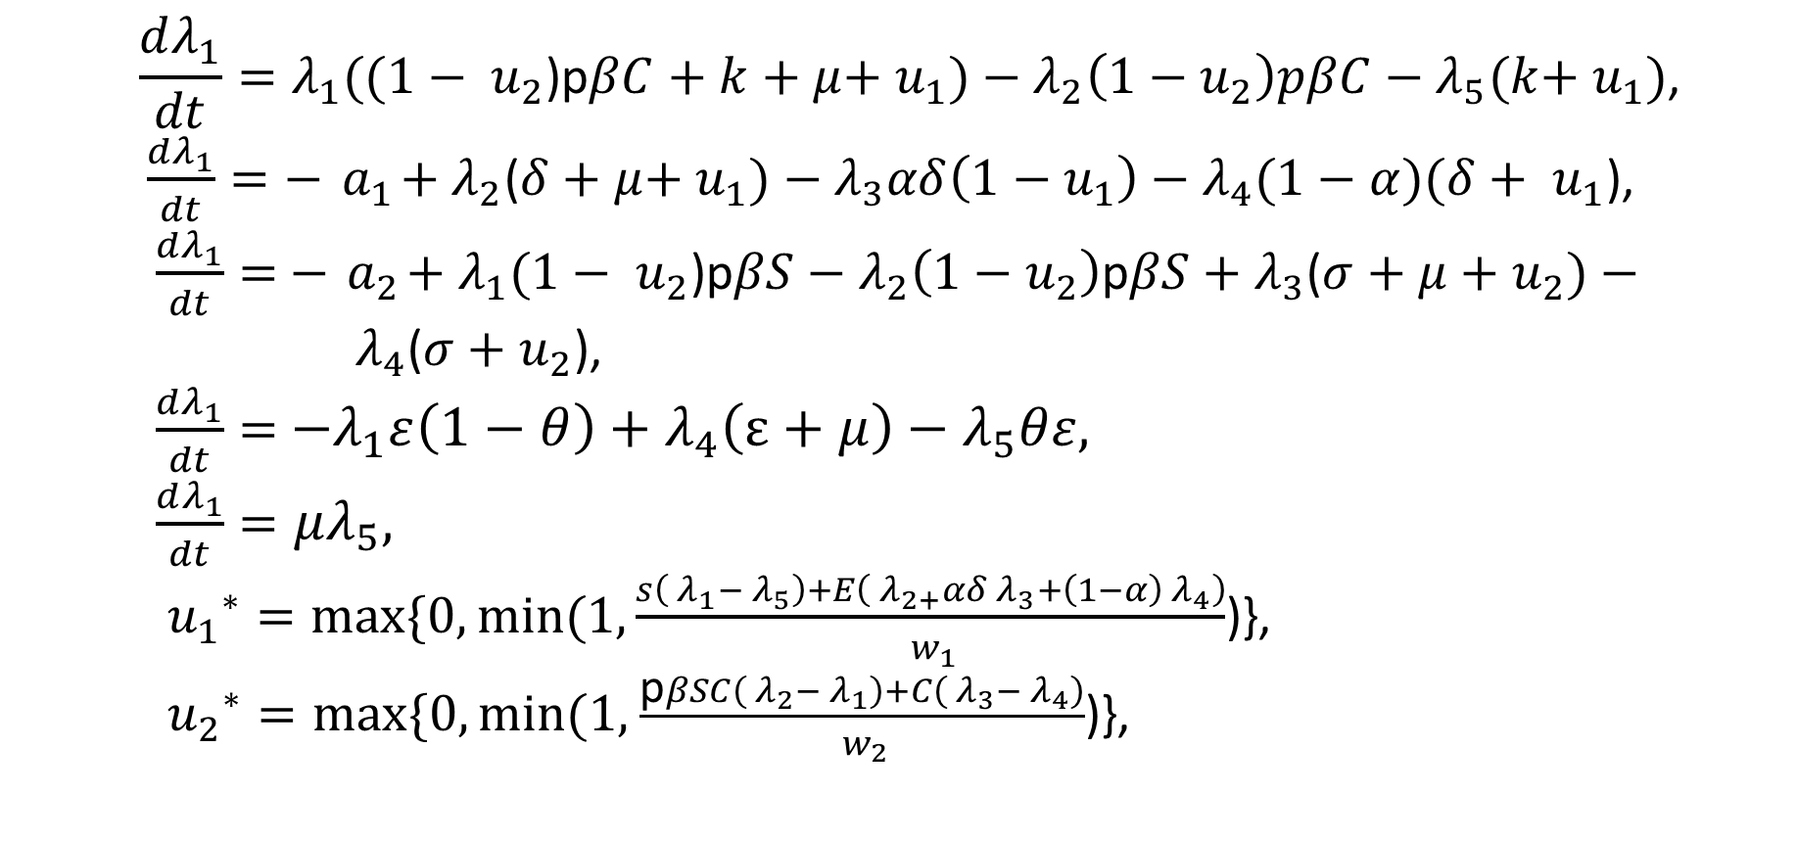
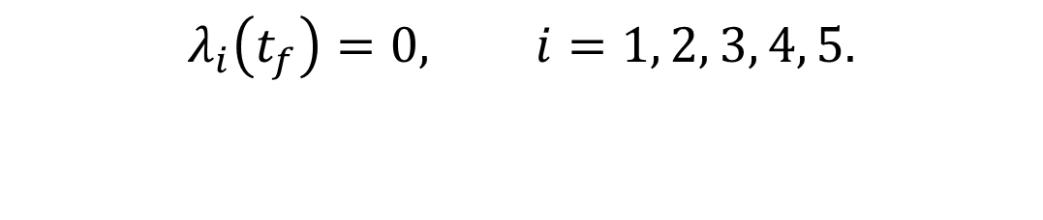
$$\frac{dλ_{1}}{dt}=λ_{1}((1−{ u}_{2}\text{)}\text{p}βC+k+μ+{ u}_{1})−λ_{2}\left(1−u_{2}\right)pβC−λ_{5}(k+{ u}_{1})\text{,}$$
$\frac{dλ_{1}}{dt}=−{ a}_{1}+λ_{2}\text{(}δ+μ+{ u}_{1})−λ_{3}αδ\left(1−{ u}_{1}\right)−λ_{4}(1−α)(δ+{ u}_{1}\text{),}$
$\frac{dλ_{1}}{dt}=$ $−{ a}_{2}+λ_{1}(1−{ u}_{2}\text{)}\text{p}βS−λ_{2}\left(1−{ u}_{2}\right)\text{p}βS+λ_{3}$($σ+μ+u_{2})− λ_{4}$($σ+u_{2}$),
$\frac{dλ_{1}}{dt}=$ ${−λ}_{1}ε\left(1−θ\right)+λ_{4}\left(ε+μ\right)−λ_{5}θε,$
$\frac{dλ_{1}}{dt}=μλ_{5},$
${{ u}_{1}}^{∗}=max⁡\{0, min⁡(1,\frac{s\left({ λ}_{1}−{ λ}_{5}\right)+E\left({ λ}_{2+}αδ{ λ}_{3}+\left(1−α\right){ λ}_{4}\right)}{{ w}_{1}}$)},
${{ u}_{2}}^{∗}=max⁡\{0, min⁡(1,$ $\frac{\text{p}βSC\left({ λ}_{2}−{ λ}_{1}\right)+C\left({ λ}_{3}−{ λ}_{4}\right)}{{ w}_{2}}$)},
$$λ_{i}\left(t_{f}\right)=0, i=1, 2, 3, 4, 5.$$
S(0) = $S_{0}$, E(0) = $E_{0}, C\left(0\right)=C_{0}, R\left(0\right)=R_{0}, H\left(0\right)=H_{0}$

Slide 32
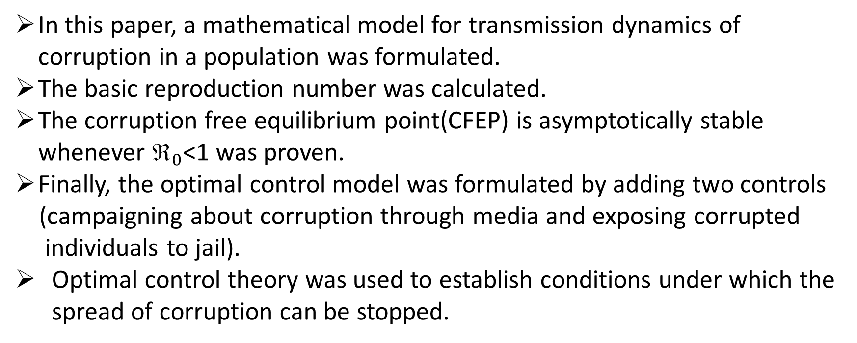
Conclusions
In this paper, a mathematical model for transmission dynamics of corruption in a population was formulated.
The basic reproduction number was calculated.
The corruption free equilibrium point(CFEP) is asymptotically stable whenever $_{0}$<1 was proven.
Finally, the optimal control model was formulated by adding two controls
(campaigning about corruption through media and exposing corrupted
individuals to jail).
Optimal control theory was used to establish conditions under which the spread of corruption can be stopped.

Slide 33
References
S.Athithan, M.Gosh, and X-Z Li, “Mathematical modelling and optimal control of corruption dynamics,” Asian-European Journal of Mathematics, vol. 11, no.6, 2018.
L. S. Pontryagin, V. Boltyanskii, R. Gamkrelidze, and E. Mishchenko, The Mathematical theory of optimal processes, New York, 1962.
https://www.hindawi.com/journals/jam/2020/5109841/
https://www.healthknowledge.org.uk/public-health-textbook/research-methods/1a-epidemiology/epidemic-theory

